Slide 1
Case study 1 ds6306
Braden Anderson and luke stodgel
SMU MSDS, DS6306 – Doing Data Science
Braden VIDEO: https://youtu.be/qbnv8eUJ5WA
Luke VIDEO: https://youtu.be/LJXjFUs8SFY

Slide 2
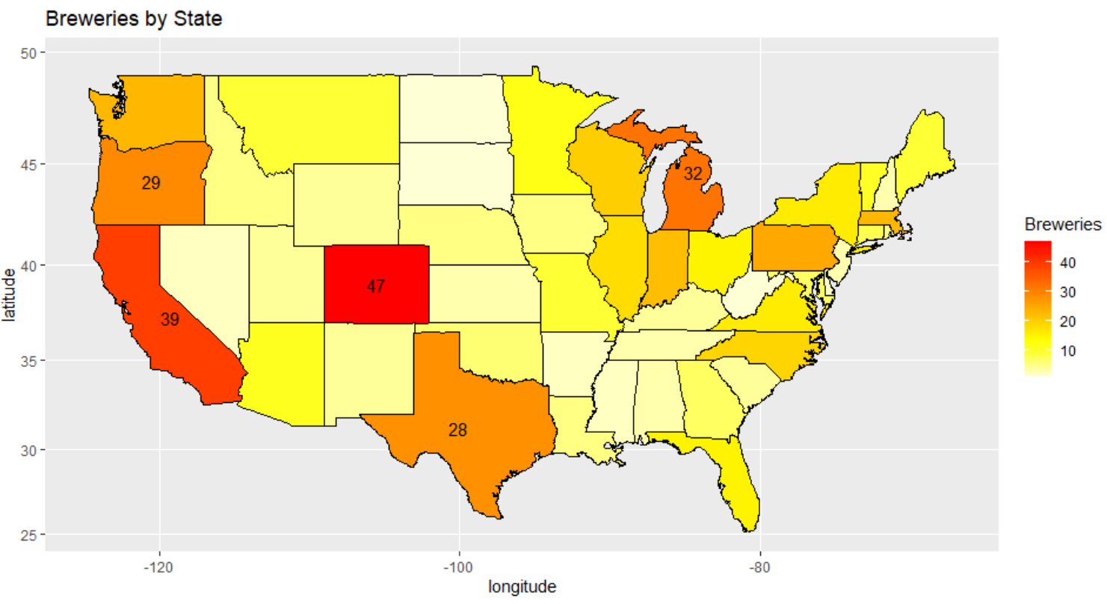
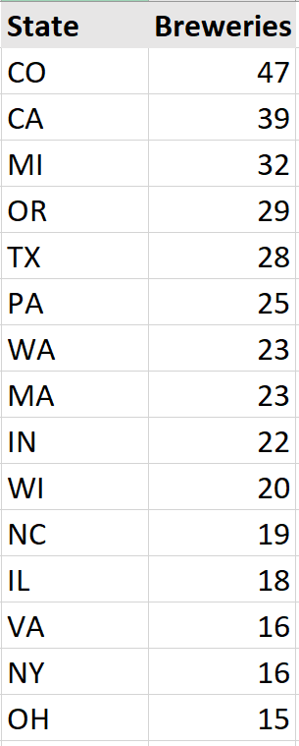
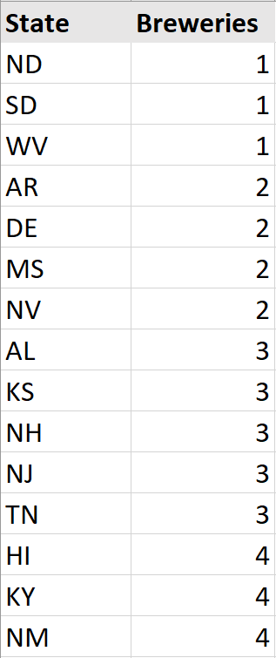
Brewery Landscape
Most
Least

Slide 3
Data Cleaning
Style
ABV
IBU
5 beers with blank “style” feature.
2 of 5 found to not be beer at all.
CROWLER
CAN’D AID
3 of 5 now have correct style information after internet search.
60 beers missing ABV information.
51 of 60 had ABV information readily available on the internet, therefore correct values were used to impute.
Ethical responsibility to not underestimate ABV information.
Domain knowledge showed that ABV is related to a beers style.
Final 9 beers had ABV imputed with the maximum ABV within the associated beer style.
1003 beers with missing IBU information.
All values imputed with the mean IBU rating for the associated beer style.
If no other beers within that style had IBU information available, the global mean IBU rating was used to impute.

Slide 4
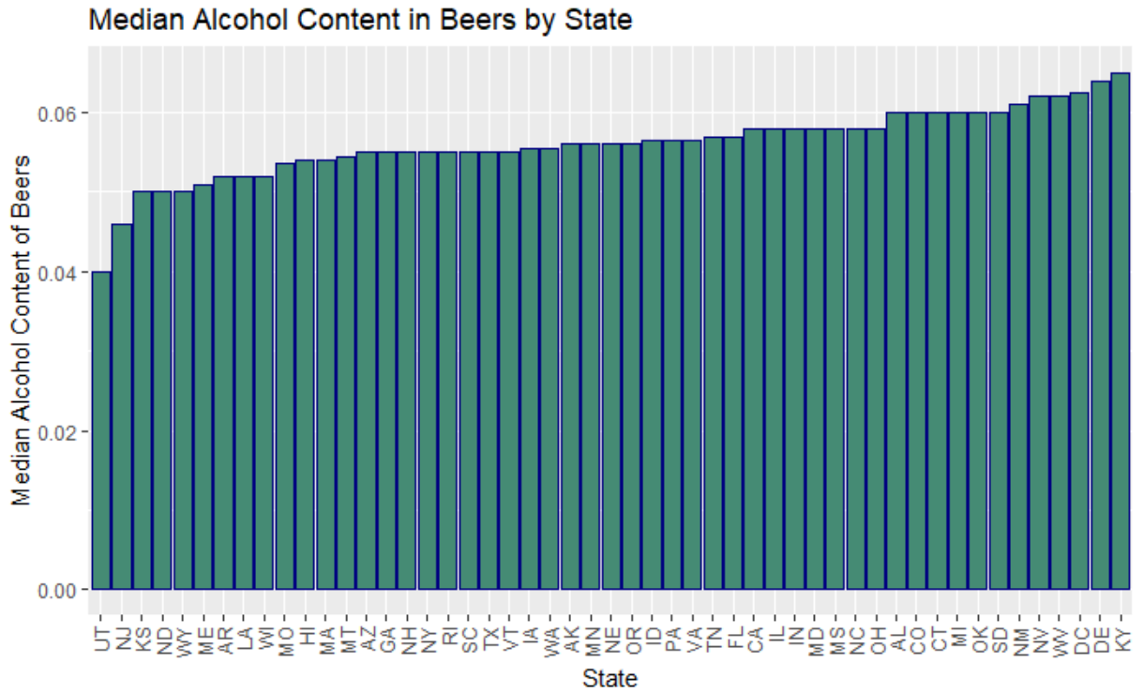
Median Alcohol By State
The states with the highest median alcohol content in their beers are also among the states with the fewest number of breweries. Could be some opportunity to expand into these areas with a higher alcohol line of products.

Slide 5
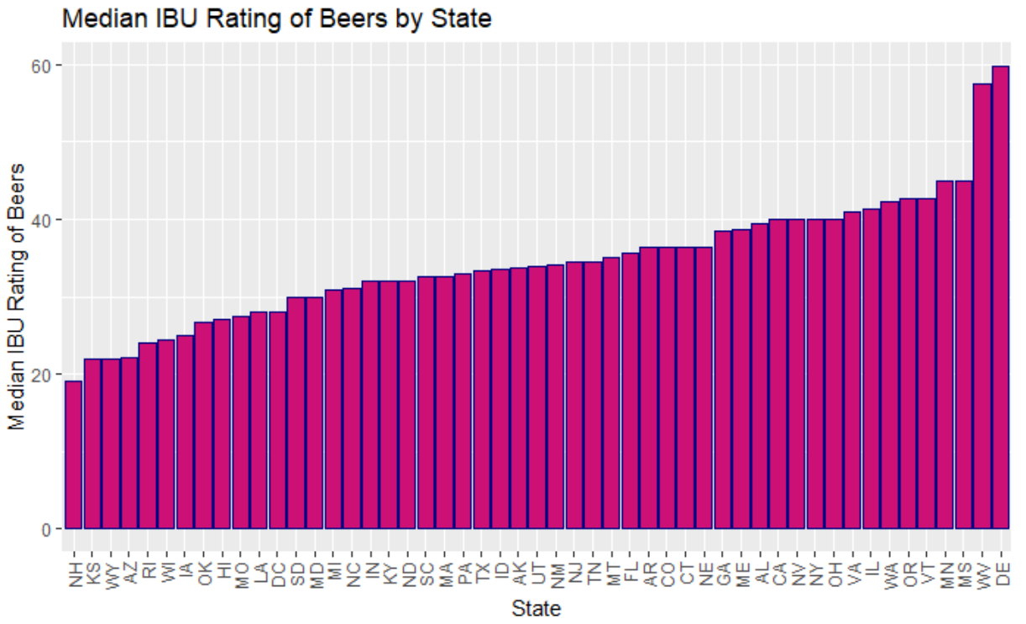
Median Bitterness By State
The majority of states tend to have median IBU ratings in the range of 25 to 40. However West Virginia and Delaware significantly exceed this mark, with median bitterness scores around 60.

Slide 6
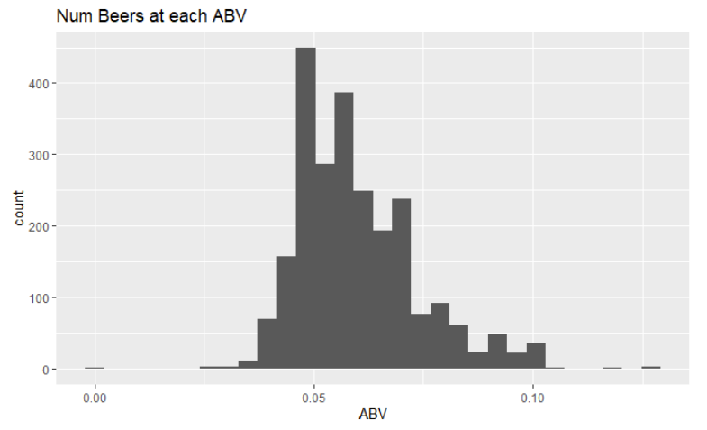
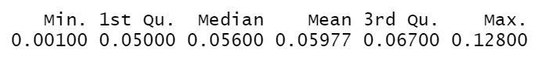
Distribution of ABV
Long tailed distribution, however is fairly symmetric about roughly 6% alcohol.

Slide 7
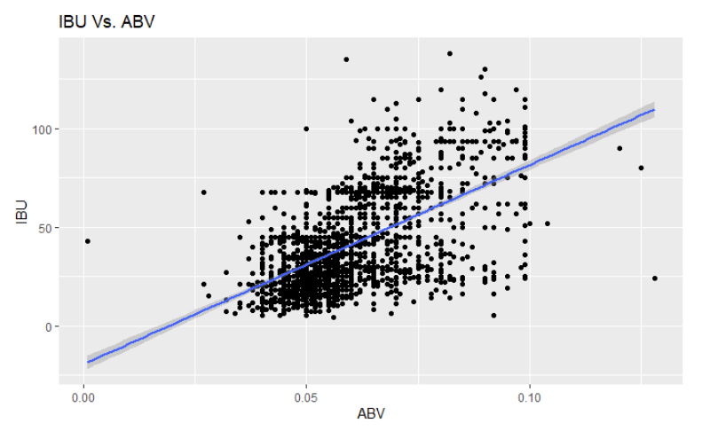
Relationship of Bitterness to Alcohol Content
Some evidence of linear trend, however there is larger variation in bitterness among beers with higher alcohol content.

Slide 8
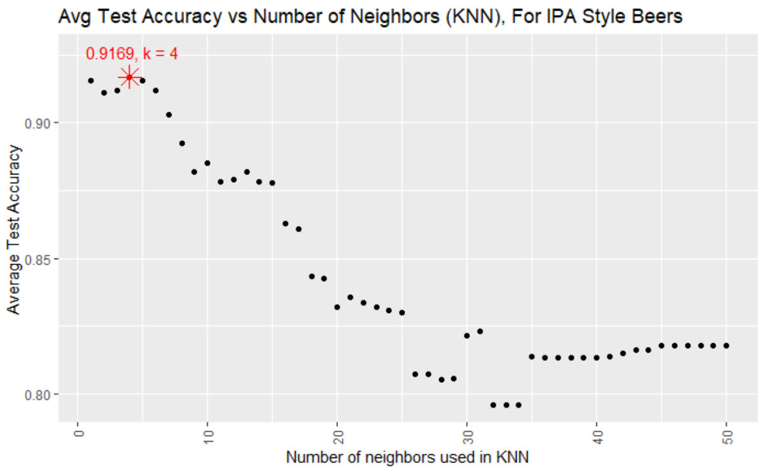
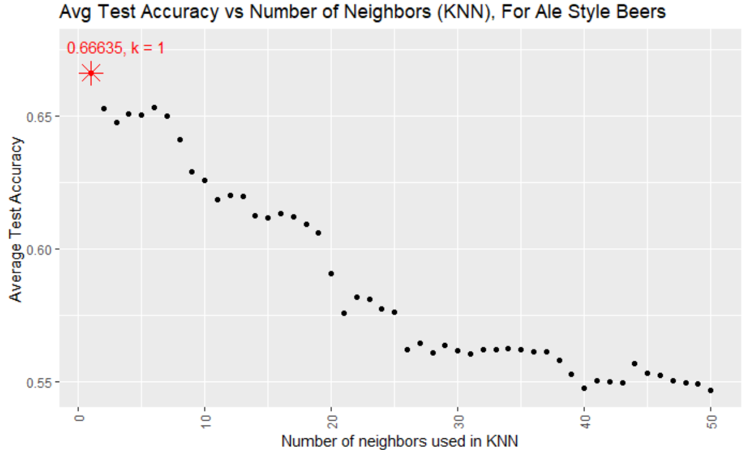
KNN Accuracy
IPA
Ale
Bitterness and Alcohol Content are more strongly related for IPA style beers than for Ale’s.

Slide 9
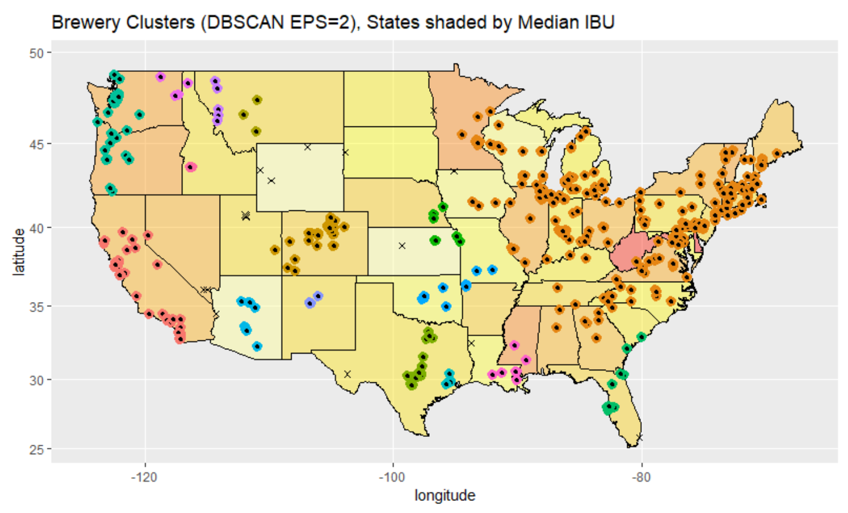
Min points=4

Slide 10
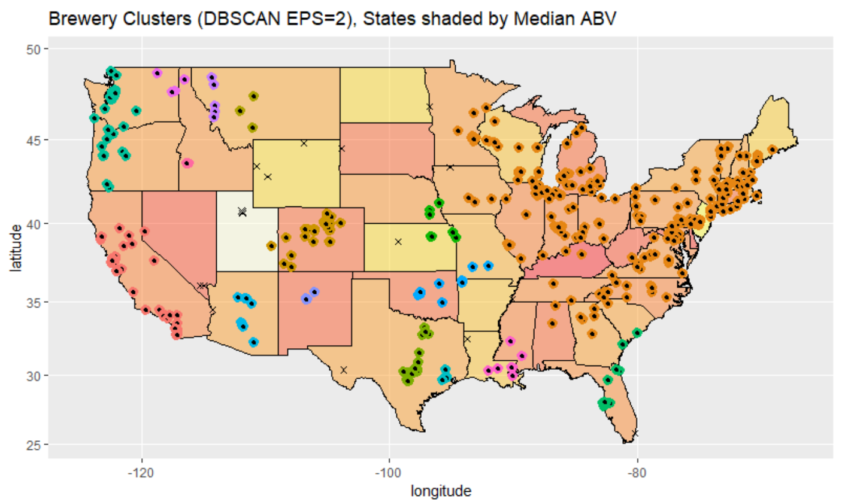
Min points=4

Slide 11
Back-up Slides

Slide 12
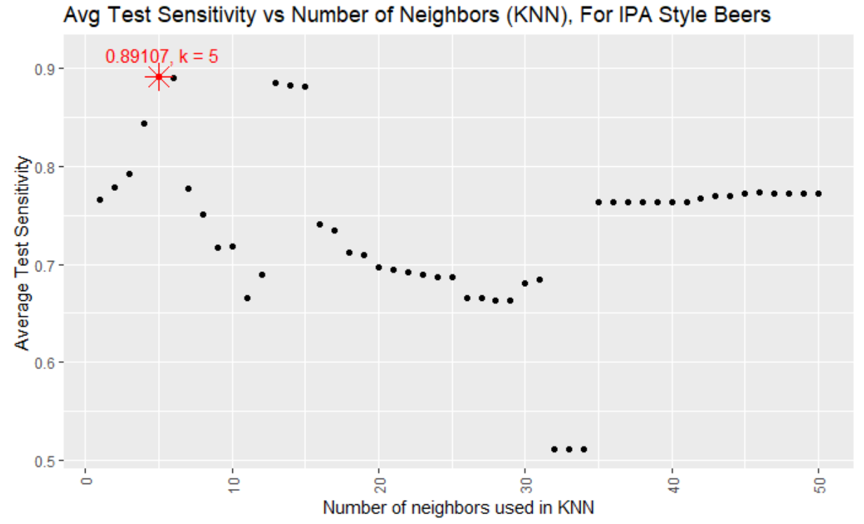
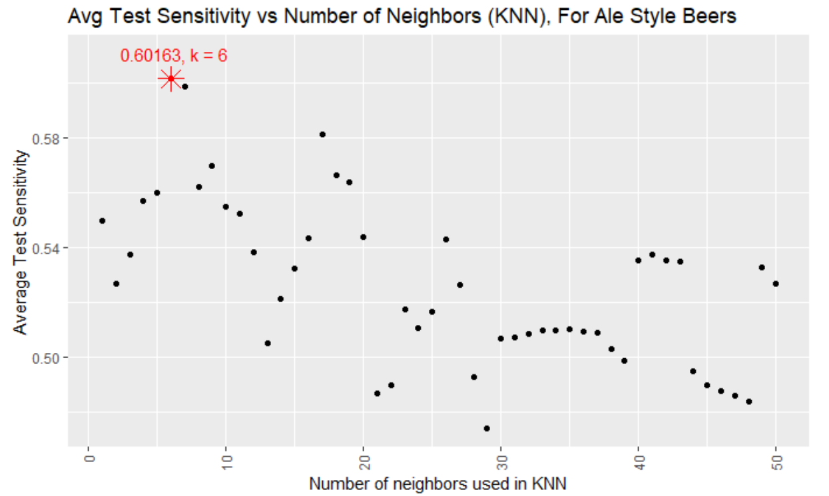
KNN Sensitivity
IPA
Ale

Slide 13
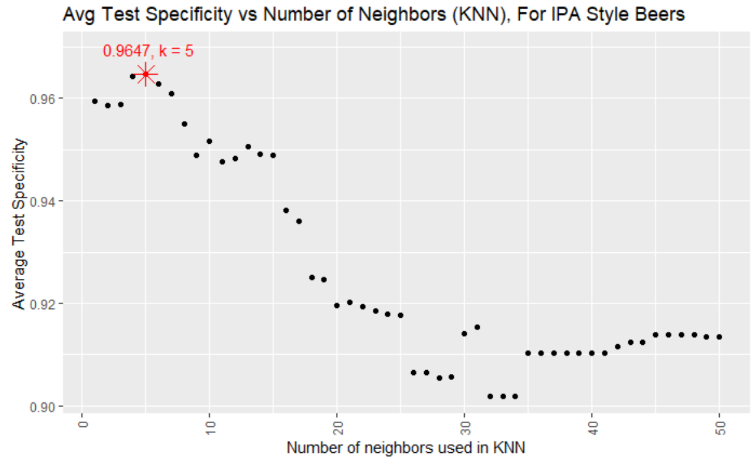
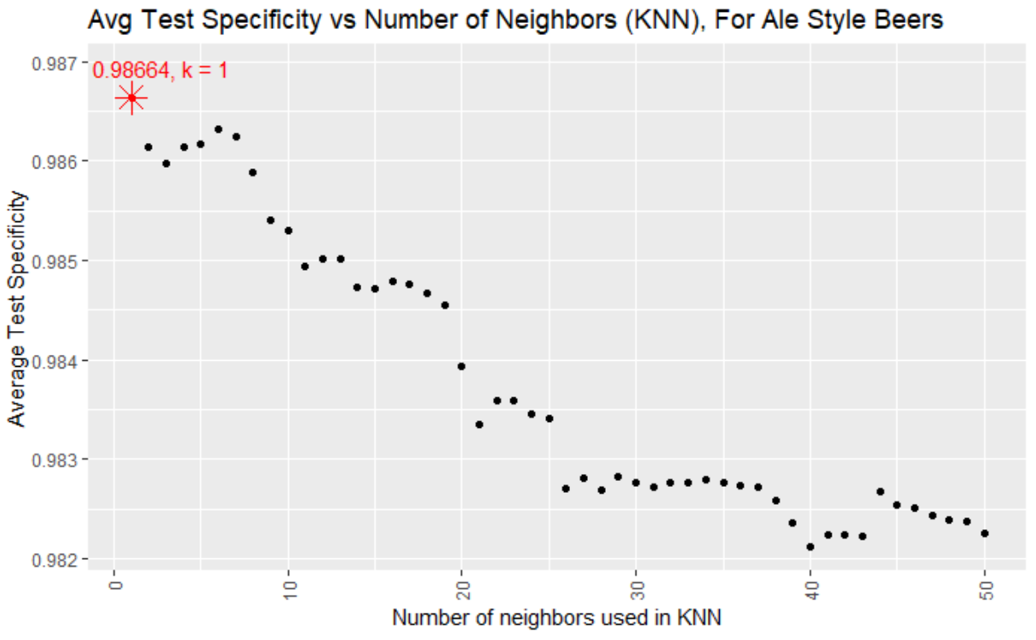
KNN Specificity
IPA
Ale

Slide 14
KMEANS Plots

Slide 15
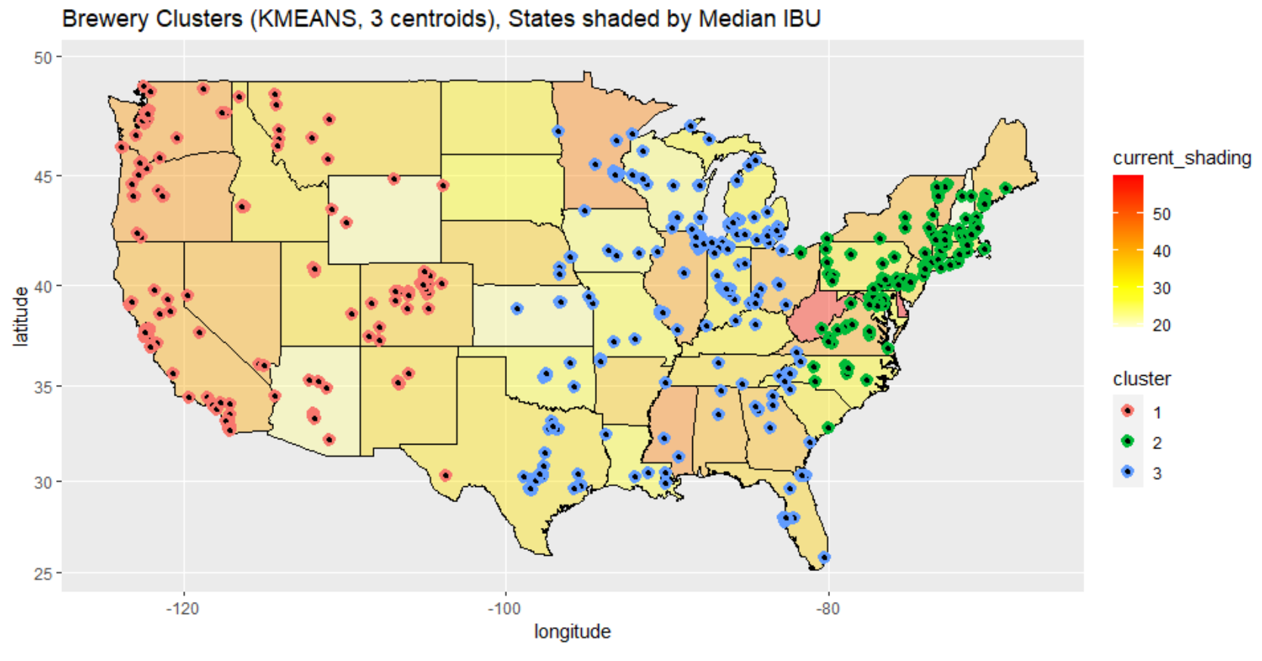

Slide 16
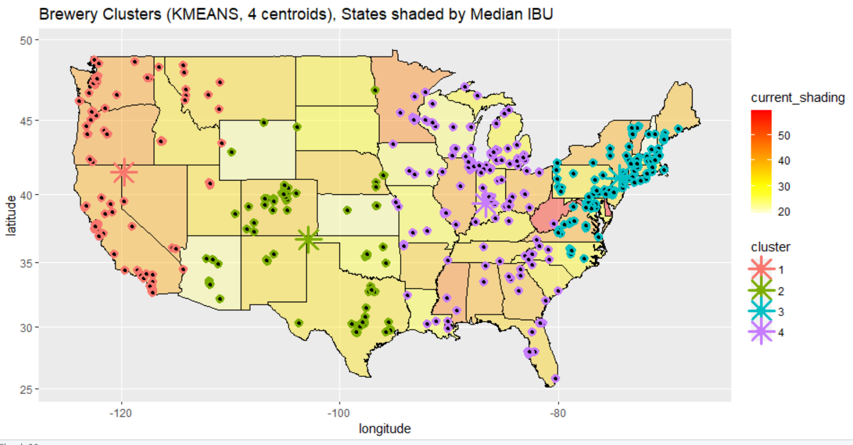

Slide 17
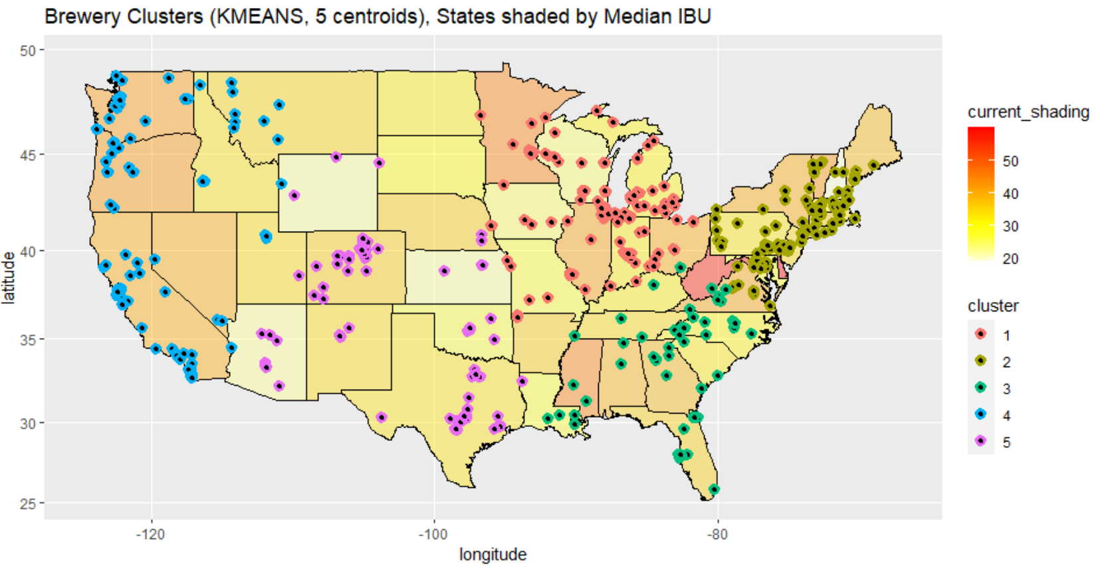

Slide 18
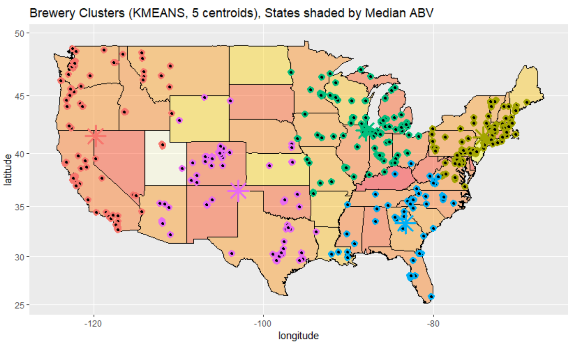

Slide 19
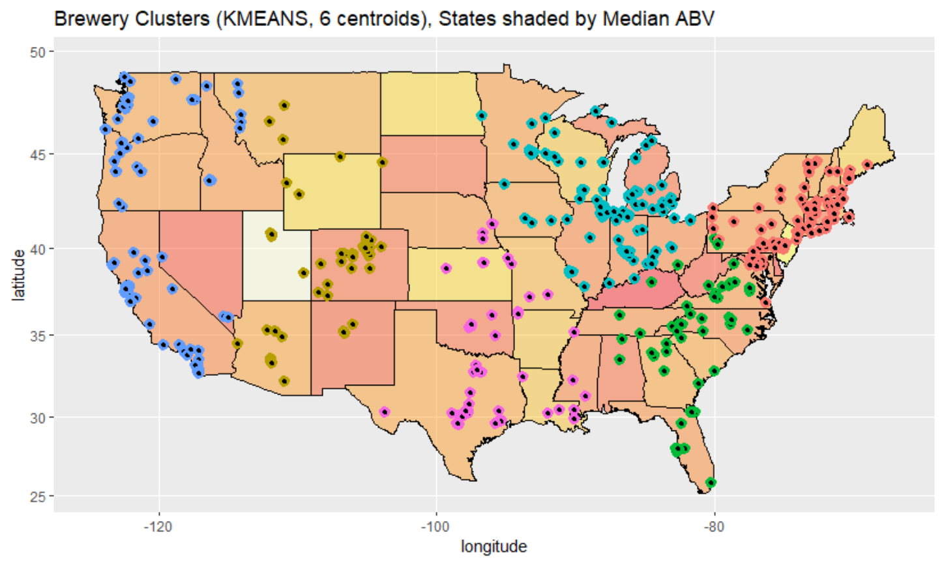

Slide 20
DBSCAN Plots

Slide 21
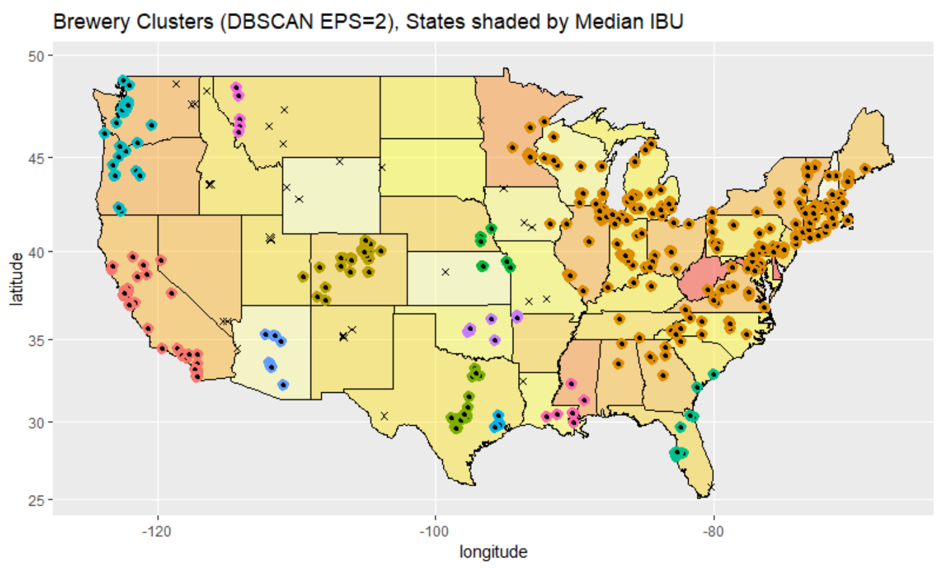

Slide 22
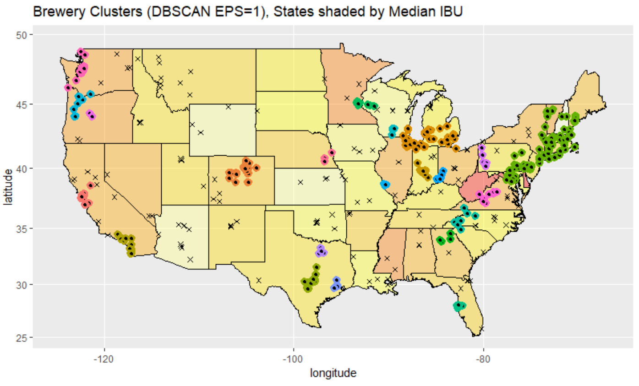

Slide 23
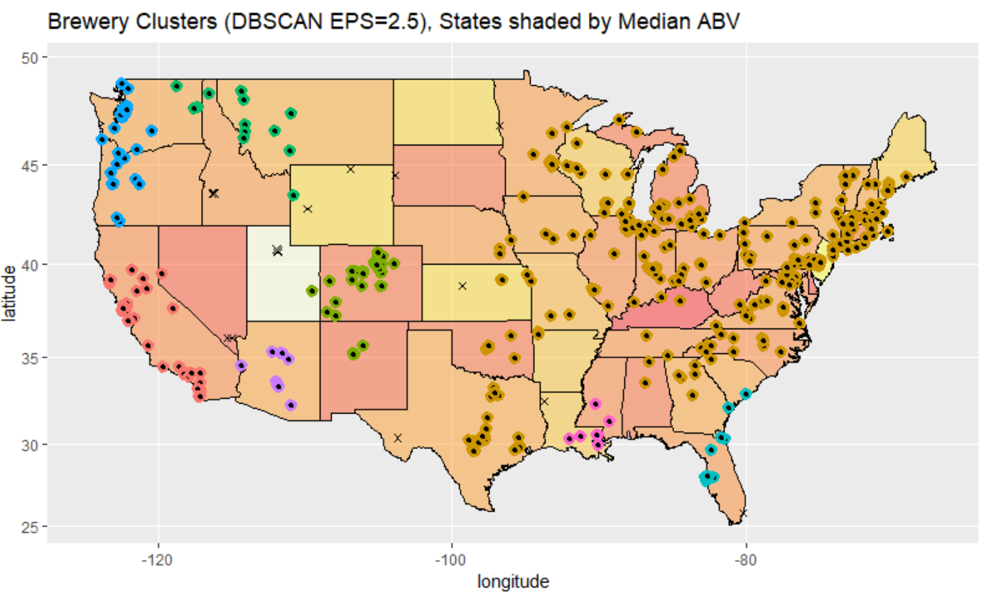

Slide 24
